Slide 1

Booking Completion Prediction - Summary

Slide 2
Objective:
Predict whether a customer will complete a holiday booking using available data.
Model Used:
Random Forest Classifier

Slide 3
Key Metrics:
Evaluated using accuracy, precision, recall
Classification Report & Confusion Matrix used
Top Predictive Features:
Purchase Lead
Flight Hour
Length of Stay
Number of Passengers
Flight Duration

Slide 4
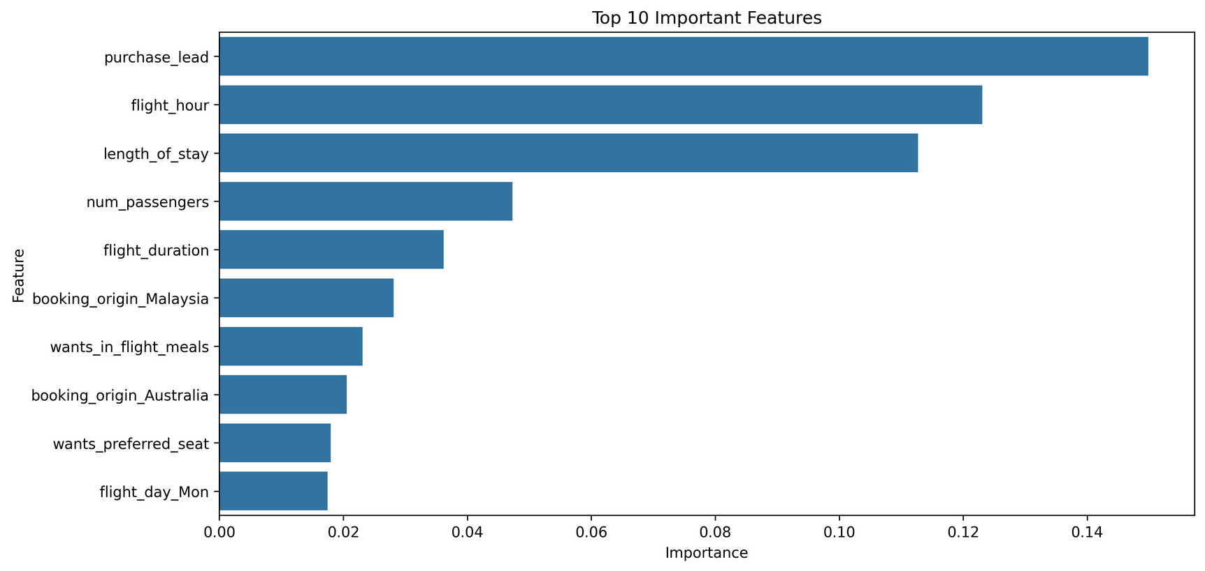
Insights:
Early planners (high purchase lead) are more likely to book
Flight time and duration affect decision-making
Booking origin like Malaysia & Australia also matters

Slide 5
Recommendation:
Target users who book in advance, prefer specific hours, and travel with longer stays.

Slide 6
Thank You

